Slide 1
How AI works
and where it fails
When can I trust what an AI tool tells me?
Applied AI and Automation | Session 2 of 12
KLAi Professional Learning | Jotham Martin Wambi
Notes:
Welcome back. Last time you chose one task from your company and measured it. Today we ask the question that decides everything else: when can you trust what an AI tool tells you? You will leave with evidence from your own task.
The question for today is this: When can I trust what an AI tool tells me? Keep it in mind. At the end of the session we come back to it and see how much more you can say.

Slide 2



Today in one view: what you will leave with
By the end of today you will have
A plain picture of how a language model produces its answers
The four ways an AI answer goes wrong, and the check that catches each one
A Reliability Test Record for your own task, filled in from three tests you ran
Notes:
Here is what you leave with today. A plain picture of how an assistant produces an answer. The four ways an answer goes wrong, and the check that catches each one. And a Reliability Test Record: three tests that you run yourself on the text of your own task.
Everything is built on what you see, so I will ask you to write down what really happened.

Slide 3
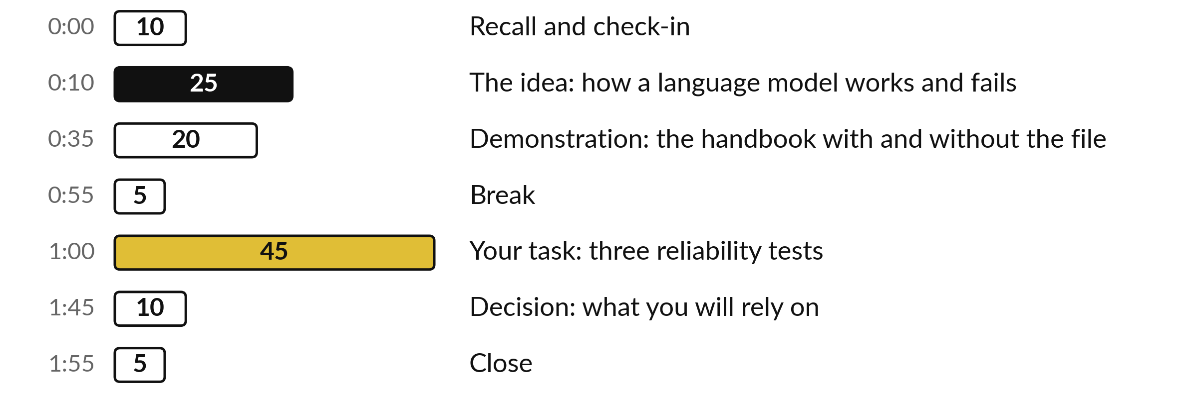
Your two hours: most of
the time is your own work
45 of the 120 minutes are yours: three tests on your own task text.
Notes:
Three parts matter most today. I explain how an assistant works and fails for twenty-five minutes, and I run one demonstration for twenty minutes. After the break, forty-five minutes are yours: three tests on your own task text. If we run long, I shorten my part and keep your testing time.

Slide 4

Three questions from last time
1. Name the four kinds of work from Session 1, and which one stays with people.
2. What is a baseline and why do you need it?
3. Read out the piece of task text you brought, or the moment this week when the task went wrong. Which kind of work is it?
Answer aloud first. Then we check together.
Notes:
Three quick questions from Session 1. Answer aloud first, and then we check together. It is a warm-up to bring last time back.
Question one. Name the four kinds of work from Session 1, and which one stays with people. Take a moment.
A good answer is this. Rules, patterns, drafting and judgement. Rules use ordinary software, patterns and drafting can use AI, and judgement stays with people.
Question two. What is a baseline and why do you need it? Say it to yourself first.
A good answer is this. How the task performs today in time, volume, errors and cost. It is the number to beat.
Question three. Read out the piece of task text you brought, or the moment this week when the task went wrong. Which kind of work is it? Think about your own task as you answer.
A good answer is this. A short answer that names one of the four kinds of work. If a learner brought nothing, use one message from customer_messages.csv.
If an answer was missing, your own task card or last workbook page has it. Now to today.

Slide 5




Words we use today
Word | What it means
Language model | The system inside an AI assistant. It predicts the next word from patterns in very large amounts of text.
Token | A small piece of text, on average about three quarters of a word. Limits and costs are counted in tokens.
Context window | Everything the assistant can see at one time: your messages, your files and its own replies.
Hallucination | A fluent answer that is false, such as an invented fact or an invented source.
Training | The one-off stage, done by the maker, where the model learns patterns from text and is then tuned to be helpful.
Notes:
Five words for today. I give the plain meaning of each, and we use every one of them before the end of the session.
Language model. The system inside an AI assistant. It predicts the next word from patterns in very large amounts of text.
Token. A small piece of text, on average about three quarters of a word. Limits and costs are counted in tokens.
Context window. Everything the assistant can see at one time: your messages, your files and its own replies.
Hallucination. A fluent answer that is false, such as an invented fact or an invented source.
Training. The one-off stage, done by the maker, where the model learns patterns from text and is then tuned to be helpful.

Slide 6
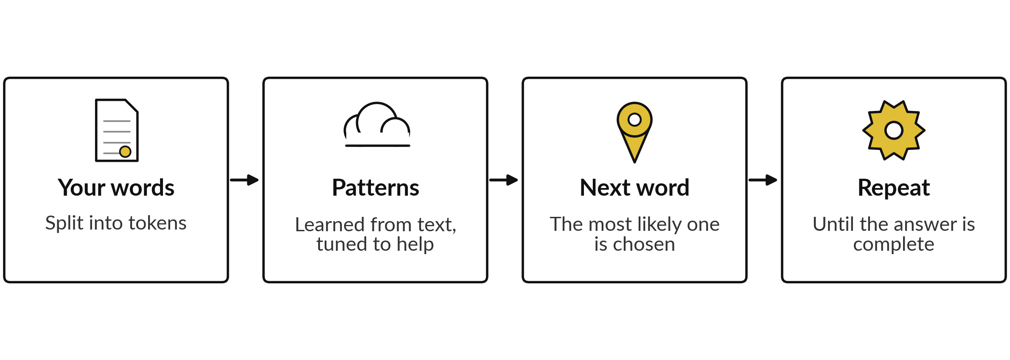
An assistant writes one likely word at a time
It writes what is likely. Only search or files can bring in facts.
Notes:
This is the whole engine in four boxes. Your words are cut into small pieces called tokens. The model has learned patterns from a huge amount of text, and the maker then tunes it to be helpful. From those patterns it picks the most likely next word, and then the next, until the answer is complete.
Nothing in that process checks a fact, unless search, files or memory are switched on. That explains why the writing is fluent, and why it can be wrong. Because it is tuned to help, it tends to answer rather than say it does not know.

Slide 7



A search engine, a spreadsheet
and an assistant do different jobs
Tool | What it does | What you get
Search engine | Finds pages that exist | Links you read and judge
Spreadsheet | Follows your formulas exactly | The same answer every time
AI assistant | Predicts likely text from patterns | A fluent answer that can differ each time
When to use which: a spreadsheet for exact answers, a search engine to find sources, an assistant to draft text that you then check.
Notes:
Compare three tools you already know. A search engine finds pages that exist, and you judge them. A spreadsheet follows your formulas exactly, so the same input gives the same answer every time. An assistant predicts likely text from patterns, so it can give a fluent answer that changes when you ask again.
Many assistants now have a search feature, and then they combine the first and the third job. Use each for what it does well. If the answer must be exact, such as a total, use the spreadsheet.

Slide 8
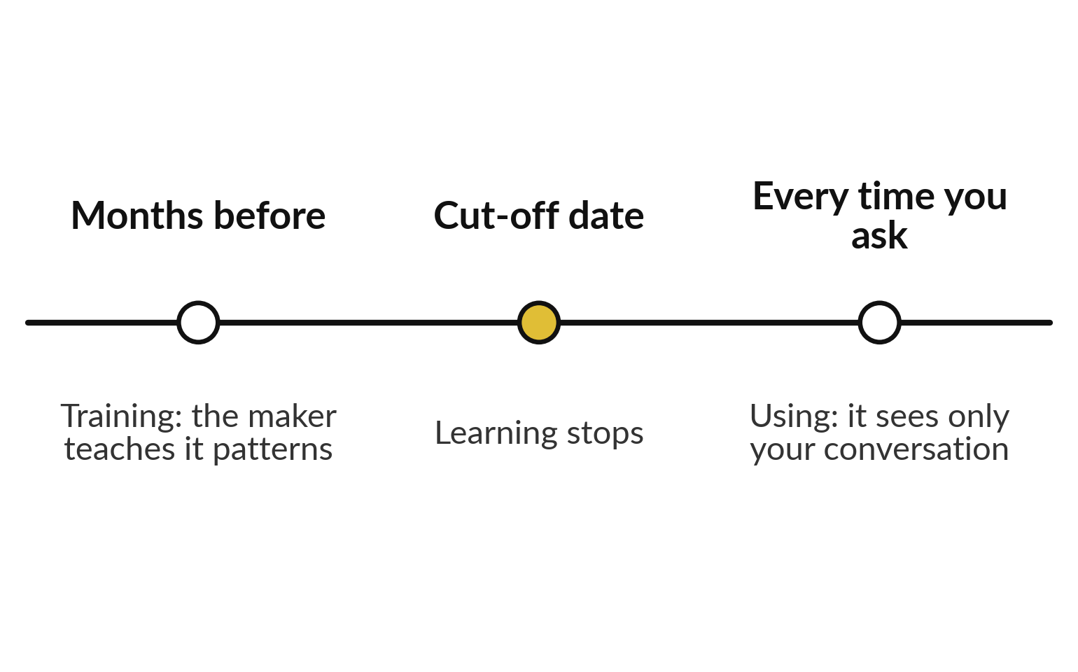
Training happens once. Using
happens every time you ask
No live knowledge unless the tool has search or your files.
Unless memory or files are on, a chat does not teach it your company.
Check which your tool has.
Notes:
Two stages. Training is done by the maker, months before you meet the tool. The model learns patterns from a huge body of text, and then it is tuned to be helpful. Its learning stops at a cut-off date. Using is what you do each time you ask.
The tool sees what is in the conversation, plus anything that search, files or memory give it. Unless one of those is switched on, it does not know your company, your prices or last week. Check which of those your own tool really has.

Slide 9
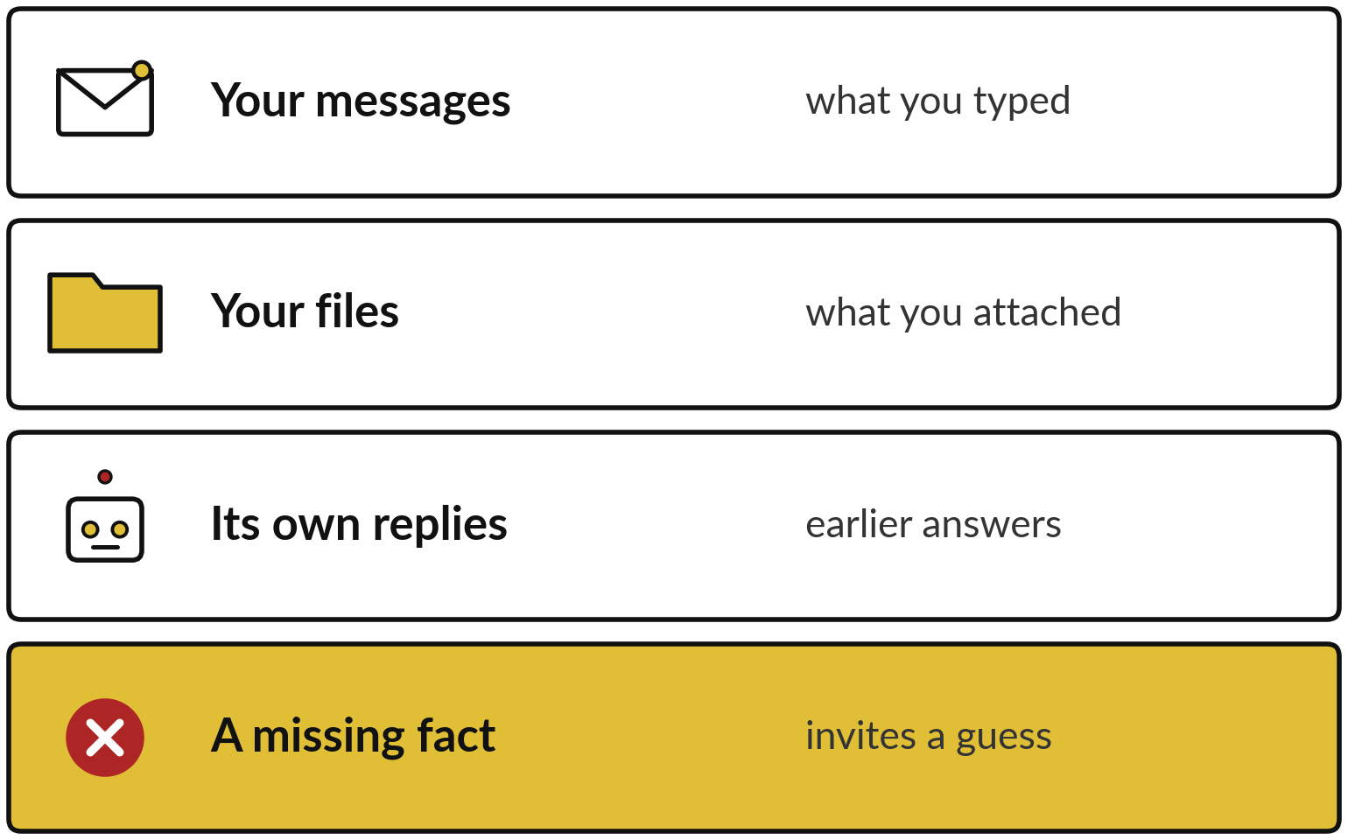
The context window is what
the assistant can see right now
Everything it knows about your task is in the conversation.
The space is limited.
Old parts of a long chat can drop out.
Giving it the fact is your job.
Notes:
The context window is the assistant working space. It holds your messages, any files you attach and its own earlier replies. It holds a limited amount, counted in tokens. In a very long chat, early parts can drop out of view, so a rule you gave at the start may be forgotten.
Most important for today, if a fact the answer needs is not in the window, the assistant is likely to fill the gap with a guess that sounds right. Giving it the fact is your job.

Slide 10
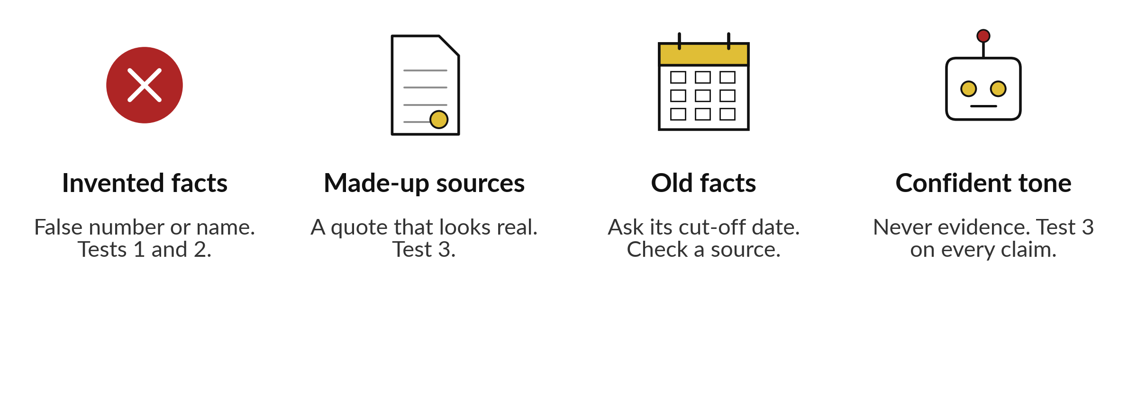
Four ways an answer fails, and the check for each
Notes:
Here are the four failures, and the check for each. Invented facts, such as a number or a name that does not exist. Tests one and two catch those. Made-up sources, a quote or reference that looks real and is not. Test three catches those. Old facts, which were true when the model was trained: ask the tool the date its knowledge ends, and check anything time sensitive against a current source.
And confident tone. The assistant sounds equally sure when it is right and when it is wrong, so tone is never evidence, and every claim needs test three. You do not need to be afraid. You need a check for each.

Slide 11
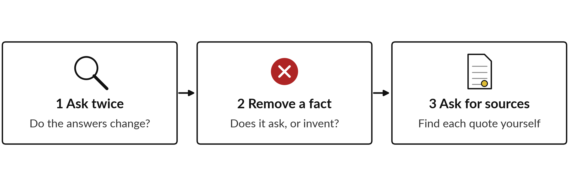
Three tests, and the failure each one catches
Same task text and same tool for all three. Old facts need the cut-off question.
Notes:
These are your three tests. One, ask twice: give the same request in two separate chats and compare. Answers that change in a way that matters tell you not to rely on a single run. Two, remove a fact the answer needs, and see whether the tool asks for it, writes NOT IN DATA, or invents it.
Three, ask for the exact words behind each part of the answer, and find three of them in your text yourself. Use the same task text and the same tool each time, and write down what really happened. Today you use the task text you brought from Session 1.

Slide 12
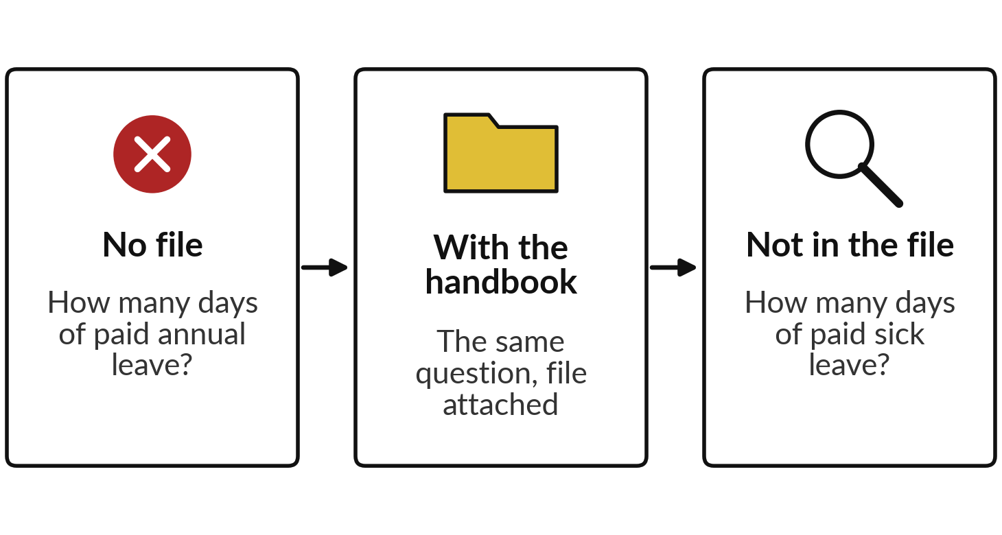
Demonstration: the handbook
question with and without the file
I will show
Watch for
Does it guess without the file?
With the file, can you find the clause it cites?
Does it admit what the handbook lacks?
Notes:
Now the demonstration, with the fictional staff handbook of Nile Valley Foods. First I ask how many days of paid annual leave staff earn, with no file. If the tool says it cannot know the company policy, I say: good, that is the behaviour we want. Now what if it had not said so?
Then the same question with the handbook attached. Then a question the handbook does not answer: how many days of paid sick leave staff get. Watch for a guess without the file, a clause you can find with it, and whether the tool admits the handbook gives no number. We check the live result.

Slide 13
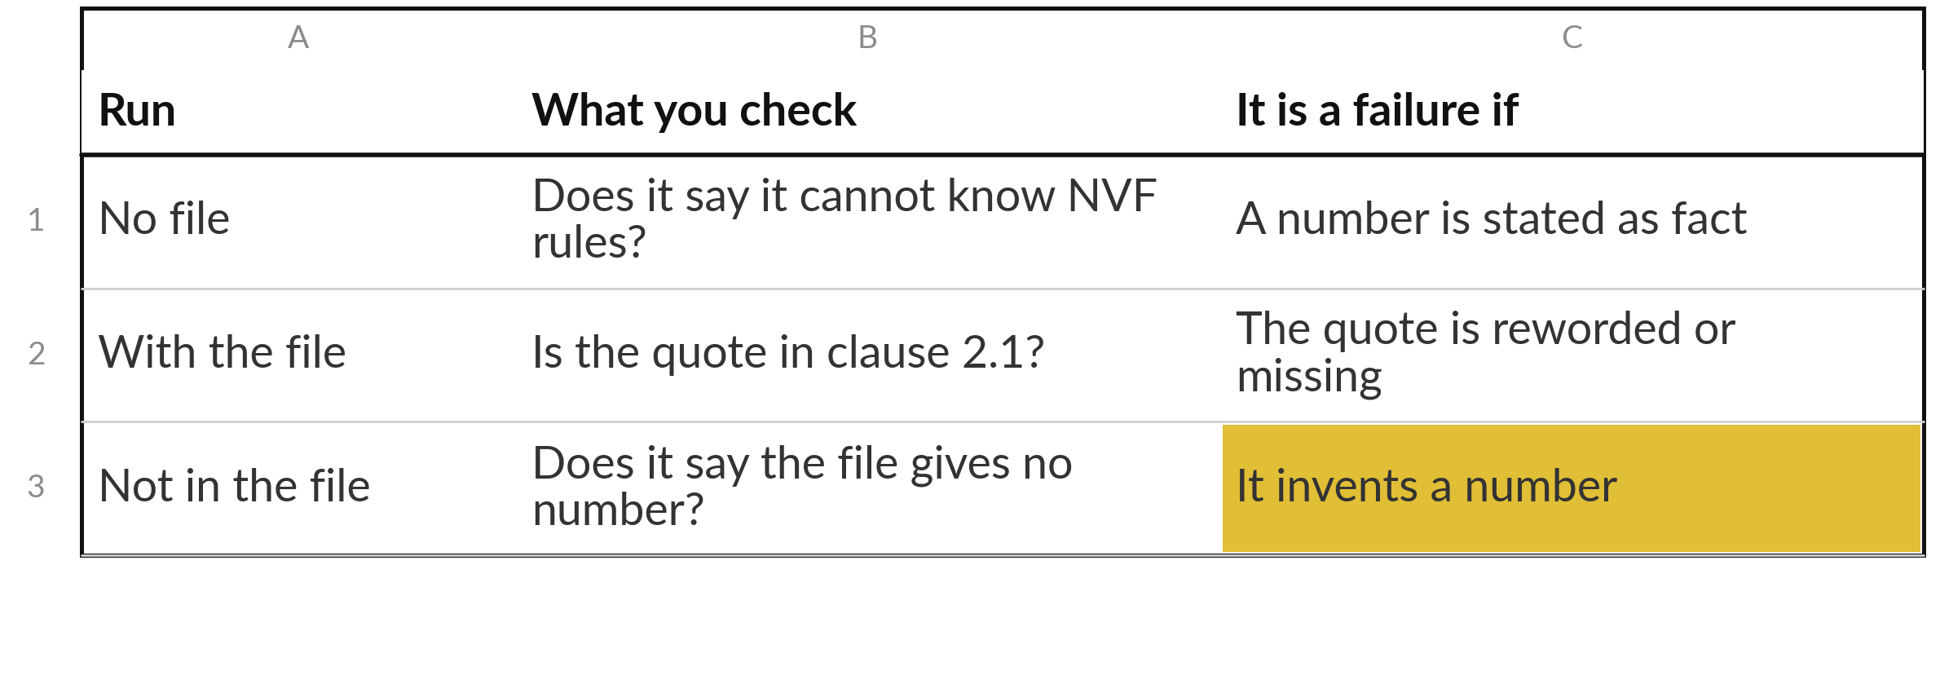
What we write down from the demonstration
Record only what you saw. If a run differs from last class, that is a useful finding.
Notes:
This is how we record it. No file: a good answer says it cannot know the company policy, and a number stated as fact is a failure. With the file: look at the clause the tool points to, then find those exact words in the handbook yourself. Not in the file: clause 2.4 does talk about sickness, but it covers only how to report it and when a medical note is needed.
A good answer says the handbook gives no number of paid sick days. An invented number is a failure, and it goes in the highlighted cell. We compare each answer with the source. We never judge by how it sounds.

Slide 14




Invented example: a record, from
a food company and a SACCO
Test | What I did | What went wrong (invented) | The check that catches it
Ask twice | Ran message M07 three times | One run read the word “late” as a complaint | A person reads any message where two runs differ
Remove a fact | Removed an invoice number | The tool named a real-looking number | Add “write NOT IN DATA” to the brief; check numbers against the sheet
Ask for source | Checked 3 of 20 quotes | One quote was reworded | Search each quote in the original
Ask twice (SACCO) | Ran a loan enquiry in English mixed with Luganda, 3 times | One run changed the loan amount | A person checks every amount; test mixed-language text on its own
Invented example. Nothing in this table was observed. Your record holds what you saw.
Notes:
Here is a finished record, as it appears in your template. These are invented examples, so they are illustrative. Three rows come from the fictional food company, and the last comes from a SACCO, to show that the method suits any business. It also shows a real risk: text that mixes languages, such as English with Luganda or Swahili, can be read less reliably, so test your own mixed messages.
See how specific each row is: what was done, what went wrong, and the check that would catch it. The last column is the valuable one, because each check becomes a step in your own process.

Slide 15
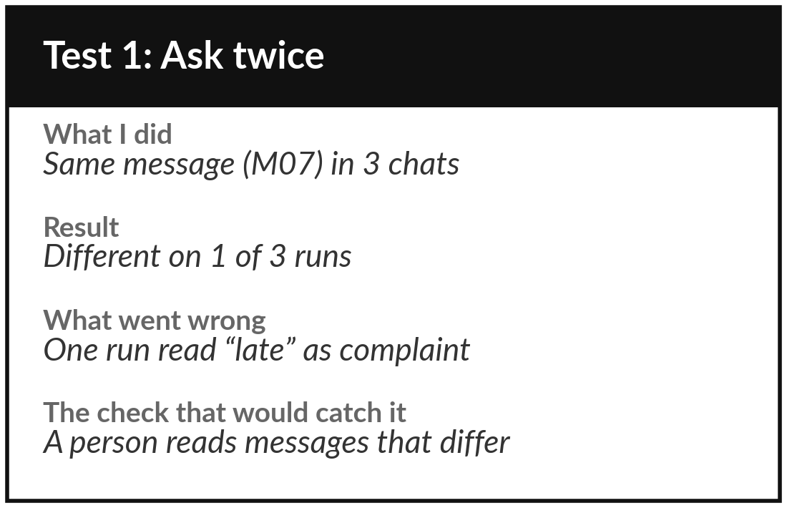
Practice: ask the same request twice and compare
15 minutes
Your own company task
Test 1: run one piece of your own task text twice, in separate chats.
Take the piece of task text you brought, with names and amounts removed.
Run the same request in two separate chats, or three times.
Compare line by line. Try a mixed-language message too, if you have one.
Write what differed and the check that would catch it.
You keep: Test 1 filled in on the Reliability Test Record.
Notes:
Take fifteen minutes. Use the piece of task text you brought from Session 1. If you brought none, I give you one message from the case company. Check that no names or amounts are left in it. Give the tool the same request in two separate chats, or three if you have time.
Compare line by line. If your text mixes languages, such as English with Luganda or Swahili, run that one too, because mixed text is a real reliability risk. If the answers differ in a way that matters, write what changed and which check would catch it. If they match, write none found, and the number of tries.

Slide 16
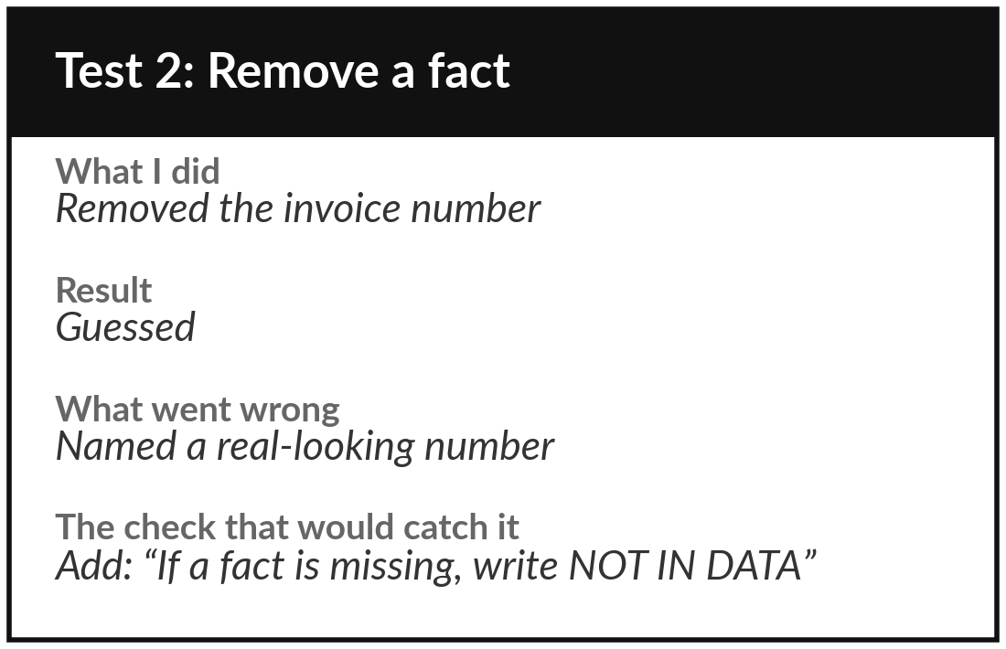
Practice: remove one fact
and see what the tool does
15 minutes
Your own company task
Test 2: leave out a fact the answer needs.
Choose a fact the answer depends on: a date, a number, a name.
Remove it from your task text.
Ask the same request. Does it ask, guess or say it is missing?
Write the result and the rule you will add to your brief.
You keep: Test 2 filled in, with one rule you will add to your brief.
Notes:
Next fifteen minutes. Take the same task text and remove one fact the answer needs. An invoice number, a date, the name of a region. Ask the same request. Three things can happen: the tool asks you for the fact, it says the fact is missing, or it invents one.
Record which. If it invents, write the rule you will add to your brief in Session 3, such as: if a fact is missing, write NOT IN DATA and ask me. We use those same words in the next session.

Slide 17
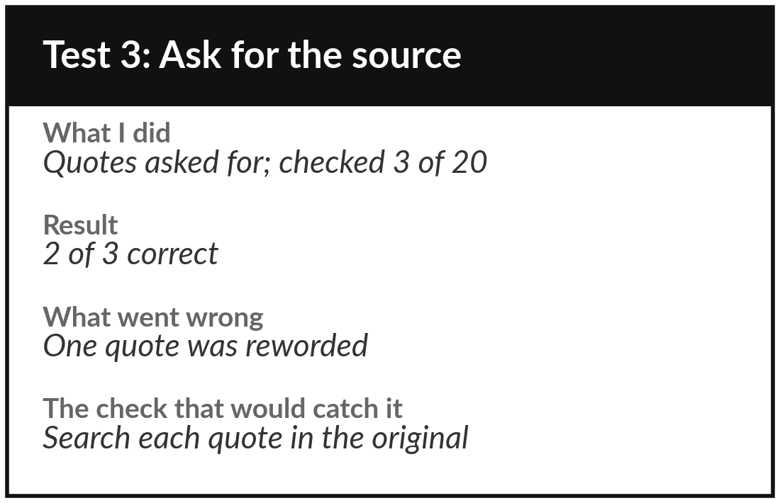
Practice: ask for the source
and check three quotes
15 minutes
Your own company task
Test 3: make the tool show where each part of its answer comes from.
Ask for the exact words in your text behind each part of the answer.
Pick three quotes and search for each one in your original text.
Ask the date its knowledge ends. Note what needs a current source.
Fill in the conclusion: rely on, always check, will not use it for.
You keep: Test 3 and your conclusion on the Reliability Test Record.
Notes:
The last fifteen minutes. Ask the tool to give the exact words from your text behind each part of its answer. Pick three of those quotes and search for each one in your original. Use the find command in your document. If a quote is reworded or not there, record it.
Then ask the tool the date its knowledge ends, and note anything in your task that depends on recent facts. Complete the conclusion section: what you can rely on the tool for, what you must always check, and what you will not use it for. Be strict, because you will build on this.

Slide 18



Decision: how far will you
rely on the tool for this task?
After your three tests, which description fits your own task?
Rely, with a check
Draft only
Keep away for now
Results were steady. A named check catches the rest.
Useful first versions. A person rewrites and verifies.
Mistakes would reach a customer or the bank. Revisit after a better brief.
Write your choice and the check that goes with it on the record.
Notes:
Time to decide. Look at your three tests. Which description fits?
Rely with a check: results were steady and a named check catches the rest. Draft only: the tool saves time on a first version but a person rewrites and verifies. Or keep it away from this task for now, because a mistake would reach a customer or the bank.
All three are good decisions when the evidence supports them. Say your choice aloud, and then write it on the record, with the check that goes with it.

Slide 19
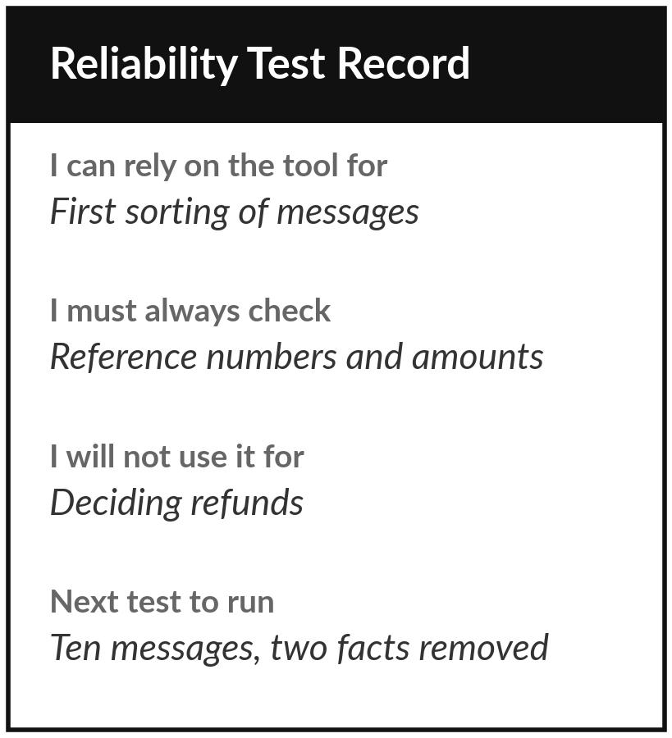
Save it, and keep it for the next session
What you keep from today
Your Reliability Test Record: three tests run on your own task text, what went wrong, and the check that would catch it.
Our question today
When can I trust what an AI tool tells me?
Next session
Session 3: Working with AI tools. You will write a brief for your own task and check what comes back.
Notes:
Keep your Reliability Test Record, because we use it in Session 3, where you write a brief that fixes the problems you found. Optional before then: try one of the three tests on a second piece of task text at work, and add a line to the record.
It is also worth noting which of search, files and memory your own tool has switched on.
We began with this question: When can I trust what an AI tool tells me? Before you go, say in one sentence what you can now say about it.

